Slide 1
Policy Learning IV: RL II

Slide 2
Last (few) Times
Passive RL
Agent follows whatever policy it is given/calculates
Policy Estimation:
Value Iteration
Policy Iteration
Direct Utility Estimation
Adaptive Dynamic Programming
Temporal-Difference Learning

Slide 3
This Time
Active RL
Agent can ignore it’s policy
Why?
Exploration/Exploitation
Q Learning
Neural Networks
How they work
Function approximators

Slide 4
Passive vs Active RL
A passive agent has a policy inside of it
Policy is fixed during an episode → agent always obeys policy
(Can be) slow
(Can be) bad
An active agent also has a policy inside of it
Agent can ignore the policy
Agent can modify the policy with new information

Slide 5
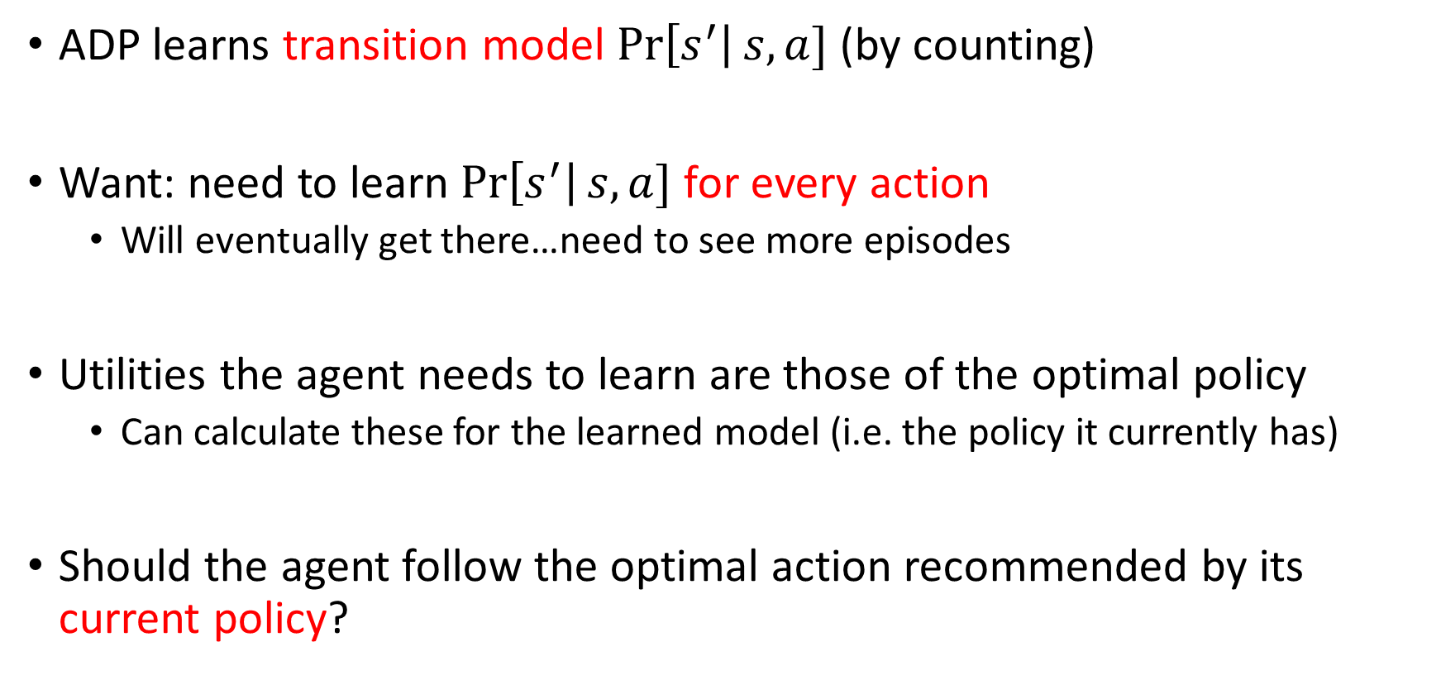
An Active ADP Agent
ADP learns transition model $\operatorname{Pr}\left[s^{′}\right|s,a]$ (by counting)
Want: need to learn $\operatorname{Pr}\left[s^{′}\right|s,a]$ for every action
Will eventually get there…need to see more episodes
Utilities the agent needs to learn are those of the optimal policy
Can calculate these for the learned model (i.e. the policy it currently has)
Should the agent follow the optimal action recommended by its current policy?

Slide 6
Always Following “Optimal” Actions
Let’s pretend we know what the optimal action is (for my current policy)
Should I follow that policy’s recommendation?
Agent is greedy
If policy is already optimal → action is truly optimal
If policy is not currently optimal → action is not truly optimal
Agent can learn bad models
Find what works
Repeat what works

Slide 7
Exploration
We want the agent to explore the world
DUE / ADP / TD assume we will eventually see every trajectory possible
Following “optimal” actions may prevent this from happening
Takeaway:
We want the agent to (sometimes) ignore it’s policy
Explore the world to see new trajectories
Improve policy with new knowledge

Slide 8
Exploration vs Exploitation
Tradeoff:
Exploitation: maximizing reward by following policy
“exploit” already learned knowledge
Exploration: gather new data to improve the model by ignoring policy
“explore” the trajectory space
The longer the model runs:
The less it should explore, and the more it should exploit
Greedy in the Limit of Infinite Exporation (GLIE):
Must try each action in each state an unbounded number of times
Eventually stop exploring and become greedy
How to explore?

Slide 9
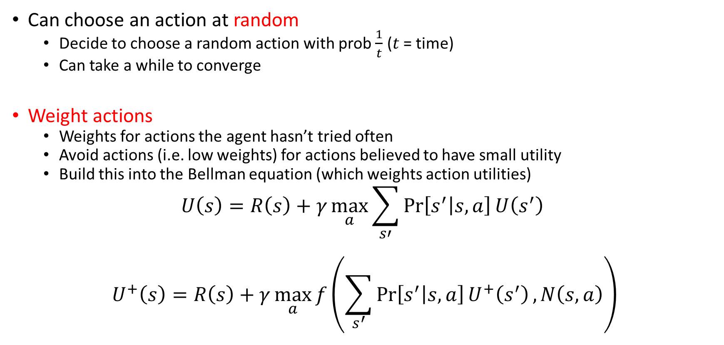
How to Explore
Can choose an action at random
Decide to choose a random action with prob $\frac{1}{t}$ ($t$ = time)
Can take a while to converge
Weight actions
Weights for actions the agent hasn’t tried often
Avoid actions (i.e. low weights) for actions believed to have small utility
Build this into the Bellman equation (which weights action utilities)
$$U\left(s\right)=R\left(s\right)+γ\max_{a}{\sum_{s′}{\operatorname{Pr}\left[s^{′} | s,a\right]U\left(s^{′}\right)}}$$
$$U^{+}\left(s\right)=R\left(s\right)+γ\max_{a}{f\left(\sum_{s^{′}}{\operatorname{Pr}\left[s^{′} | s,a\right]U^{+}\left(s^{′}\right)}, N\left(s,a\right)\right)}$$
# of times we’ve taken a in s

Slide 10
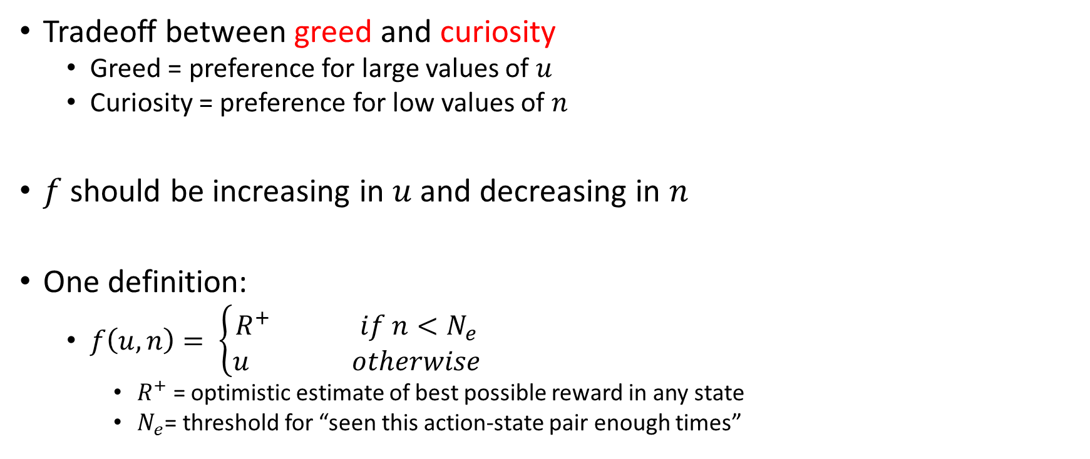


The Exploration Function $f(u,n)$
Tradeoff between greed and curiosity
Greed = preference for large values of $u$
Curiosity = preference for low values of $n$
$f$ should be increasing in $u$ and decreasing in $n$
One definition:
$f\left(u,n\right)= \left\{\begin{aligned}R^{+} if n<N_{e} \\ u otherwise\end{aligned}\right.$
$R^{+}$ = optimistic estimate of best possible reward in any state
$N_{e}$= threshold for “seen this action-state pair enough times”
$$R^{+}≥\max{u}$$

Slide 11
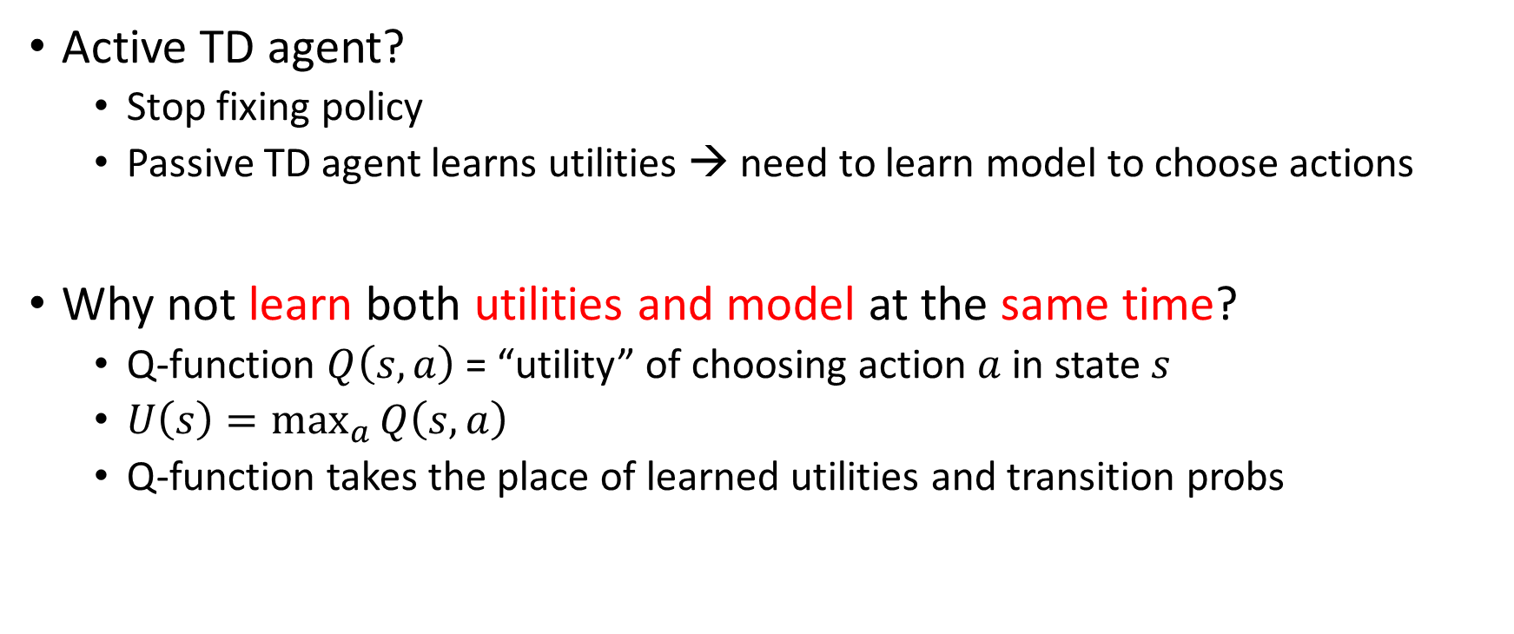
Learning Action-Utility functions
Active TD agent?
Stop fixing policy
Passive TD agent learns utilities → need to learn model to choose actions
Why not learn both utilities and model at the same time?
Q-function $Q\left(s,a\right)$ = “utility” of choosing action $a$ in state $s$
$U\left(s\right)=\max_{a}{Q\left(s,a\right)}$
Q-function takes the place of learned utilities and transition probs

Slide 12
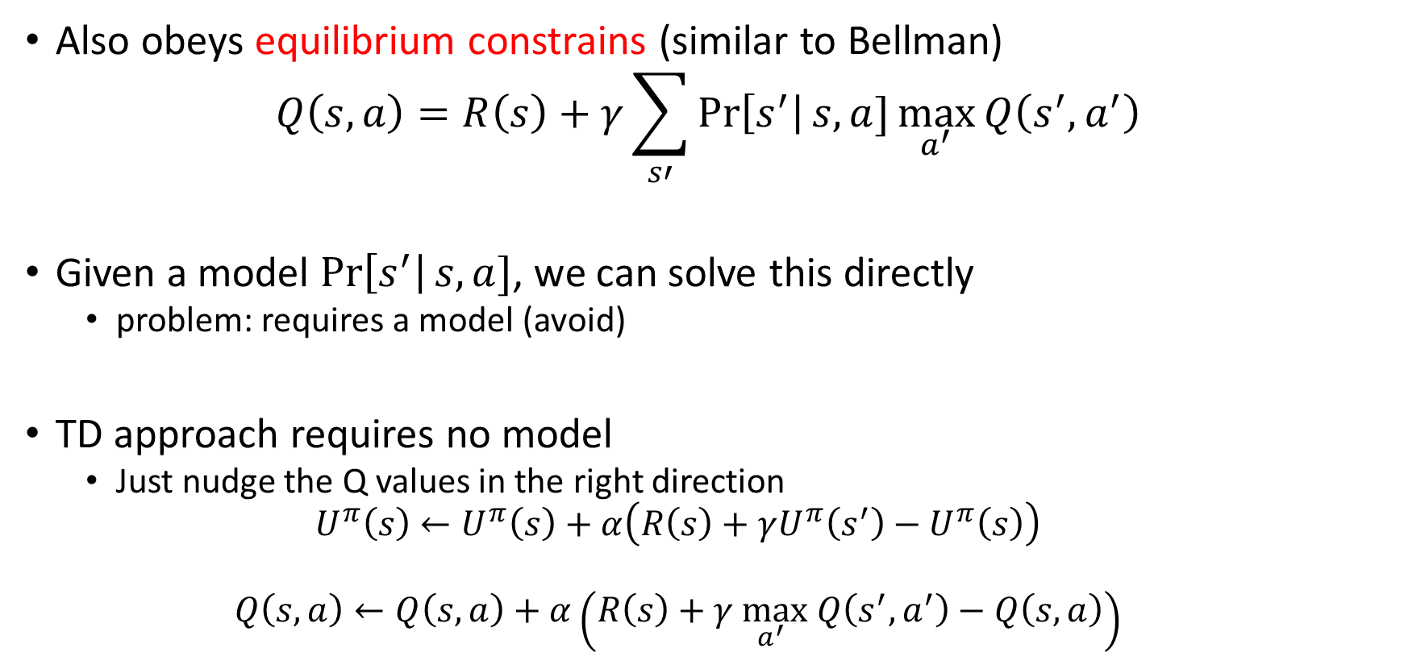
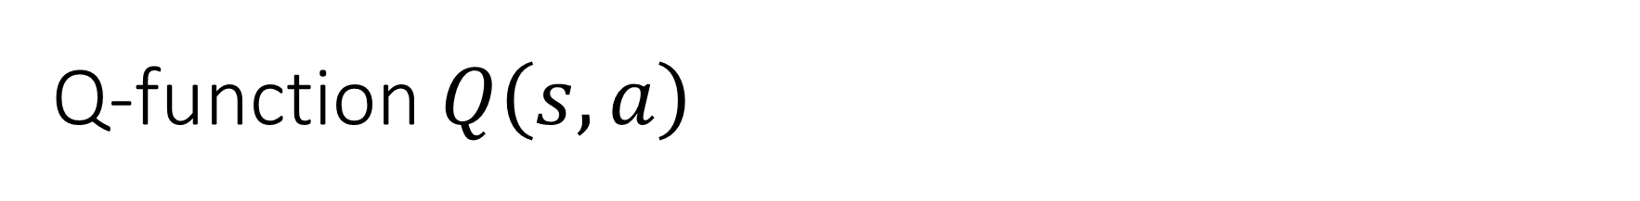
Q-function $Q\left(s,a\right)$
Also obeys equilibrium constrains (similar to Bellman)
$$Q\left(s,a\right)=R\left(s\right)+γ\sum_{s′}{\operatorname{Pr}\left[s^{′}\right|s,a]\max_{a^{′}}{Q\left(s^{′},a^{′}\right)}}$$
Given a model $\operatorname{Pr}\left[s^{′}\right|s,a]$, we can solve this directly
problem: requires a model (avoid)
TD approach requires no model
Just nudge the Q values in the right direction
$$U^{π}\left(s\right)←U^{π}\left(s\right)+α\left(R\left(s\right)+γU^{π}\left(s^{′}\right)−U^{π}\left(s\right)\right)$$
$$Q\left(s,a\right)←Q\left(s,a\right)+α\left(R\left(s\right)+γ\max_{a^{′}} Q\left(s^{′},a^{′}\right)−Q\left(s,a\right)\right)$$

Slide 13
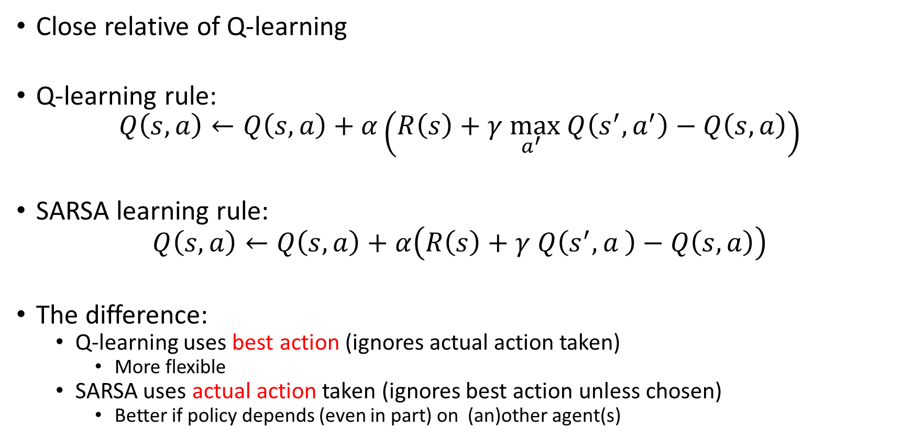
State-Action-Reward-State-Action (SARSA)
Close relative of Q-learning
Q-learning rule:
$$Q\left(s,a\right)←Q\left(s,a\right)+α\left(R\left(s\right)+γ\max_{a^{′}} Q\left(s^{′},a^{′}\right)−Q\left(s,a\right)\right)$$
SARSA learning rule:
$$Q\left(s,a\right)←Q\left(s,a\right)+α\left(R\left(s\right)+γ Q\left(s^{′},a^{ }\right)−Q\left(s,a\right)\right)$$
The difference:
Q-learning uses best action (ignores actual action taken)
More flexible
SARSA uses actual action taken (ignores best action unless chosen)
Better if policy depends (even in part) on (an)other agent(s)

Slide 14
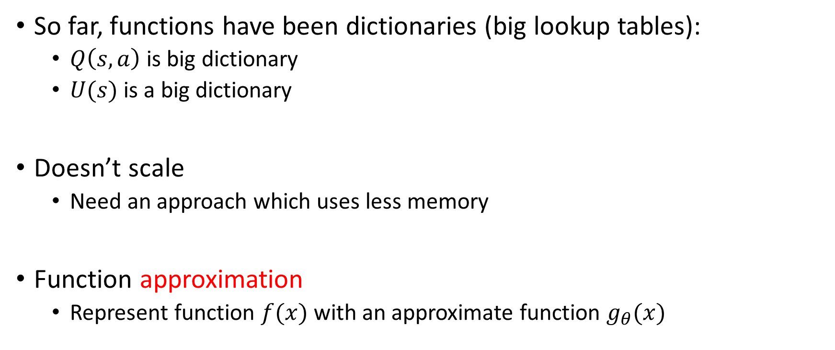
Generalized RL
So far, functions have been dictionaries (big lookup tables):
$Q\left(s,a\right)$ is big dictionary
$U(s)$ is a big dictionary
Doesn’t scale
Need an approach which uses less memory
Function approximation
Represent function $f(x)$ with an approximate function $g_{θ}(x)$

Slide 15
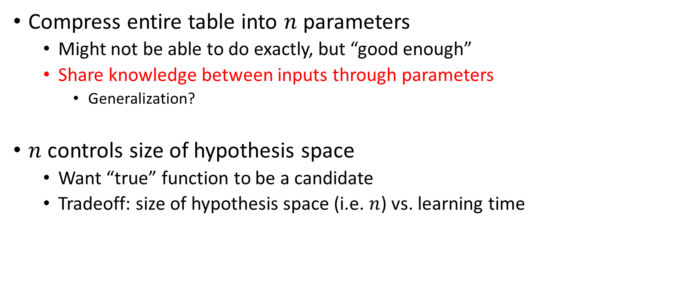
Function Approximation
Compress entire table into $n$ parameters
Might not be able to do exactly, but “good enough”
Share knowledge between inputs through parameters
Generalization?
$n$ controls size of hypothesis space
Want “true” function to be a candidate
Tradeoff: size of hypothesis space (i.e. $n$) vs. learning time

Slide 16












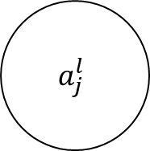




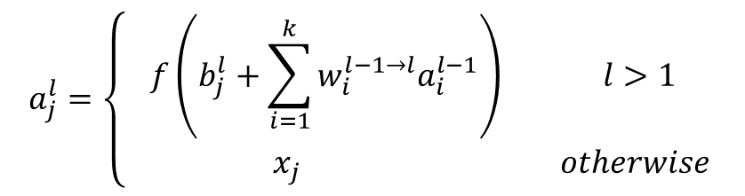













Neural Networks
$$a_{j}^{l}=\left\{\begin{aligned}f\left(b_{j}^{l}+\sum_{i=1}^{k}{w_{i}^{l−1→l}a_{i}^{l−1}}\right) l>\text{1} \\ { x}_{j} otherwise\end{aligned}\right.$$
Neural Networks are really powerful function approximators
Really useful models in their own right
We will use them for function approximators in RL
Layer $l−1$
Layer $l$
$$w_{1,1}^{1→2}$$
$$a_{1}^{l−1}$$
$$x_{1}$$
$$a_{1}^{1}$$
$$w_{1,j}^{l−1→l}$$
$$w_{1,2}^{1→2}$$
$$a_{1}^{2}$$
$$y_{1}$$
$$b_{1}^{2}$$
$$w_{2,j}^{l−1→l}$$
$$a_{j}^{l}$$
$$w_{2,1}^{1→2}$$
$$a_{2}^{l−1}$$
$$a_{2}^{1}$$
$$w_{3,j}^{l−1→l}$$
$$x_{2}$$
$$w_{2,2}^{1→2}$$
$$a_{3}^{l−1}$$
$$w_{3,1}^{1→2}$$
$$b_{j}^{l}$$
$$a_{2}^{2}$$
$$y_{2}$$
$$w_{k,j}^{l−1→l}$$
$$b_{2}^{2}$$
$$x_{3}$$
$$a_{3}^{1}$$
$$w_{3,2}^{1→2}$$
$$a_{k}^{l−1}$$

Slide 17









































Neural Networks: Forward Propagation
$$a_{1}^{1}=x_{1}$$
$$a_{1}^{2}=f( )$$
$$b_{1}^{2}+$$
$$w_{1,1}^{1→2}a_{1}^{1}+$$
$$w_{2,1}^{1→2}a_{2}^{1}+$$
$$w_{3,1}^{1→2}a_{3}^{1}$$
$$a_{1}^{1}$$
$$a_{1}^{1}$$
$$w_{1,1}^{1→2}$$
$$w_{1,1}^{1→2}a_{1}^{1}$$
$$x_{1}$$
$$a_{1}^{2}$$
$$y_{1}$$
$$a_{1}^{1}$$
$${w_{2,1}^{1→2}a}_{2}^{1}$$
$$b_{1}^{2}$$
$$w_{2,1}^{1→2}$$
$$w_{1,2}^{1→2}$$
$${w_{1,2}^{1→2}a}_{1}^{1}$$
$$a_{2}^{1}=x_{2}$$
$$a_{2}^{1}$$
$$x_{2}$$
$$a_{2}^{1}$$
$$a_{2}^{1}$$
$${w_{3,1}^{1→2}a}_{3}^{1}$$
$$w_{2,2}^{1→2}$$
$$w_{3,1}^{1→2}$$
$${w_{2,2}^{1→2}a}_{2}^{1}$$
$$a_{2}^{2}=f\left( \right)$$
$$b_{2}^{2}+$$
$$w_{1,2}^{1→2}a_{1}^{1}+$$
$$w_{2,2}^{1→2}a_{2}^{1}+$$
$$w_{3,2}^{1→2}a_{3}^{1}$$
$$a_{3}^{1}$$
$$a_{3}^{1}=x_{3}$$
$$a_{2}^{2}$$
$$y_{2}$$
$$x_{3}$$
$$a_{3}^{1}$$
$$a_{3}^{1}$$
$$w_{3,2}^{1→2}$$
$${w_{3,2}^{1→2}a}_{3}^{1}$$
$$b_{2}^{2}$$

Slide 18
Updating the Network Parameters
TODO
Next Time

